Slide 1
Why Prosody Matters
The Meaning of Proper Pronunciation in Public Speaking

Slide 2

What is prosody?
prosody is concerned with those elements of speech that are not individual phonetic segments (vowels and consonants) but are properties of syllables and larger units of speech, including linguistic functions such as intonation, tone, stress, and rhythm. Such elements are known as suprasegmentals.

Slide 3

Why is Prosody Important?
Words mean more than what is set down on paper. It takes the human voice to infuse them with deeper meaning. – Maya Angelou

Slide 4
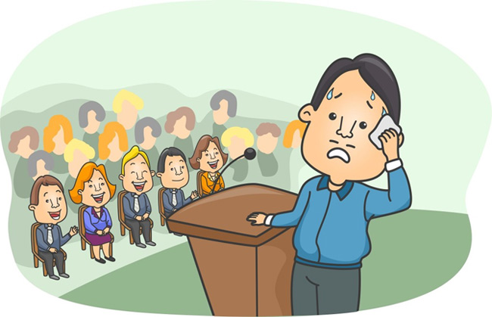
Fear of the public

Slide 5

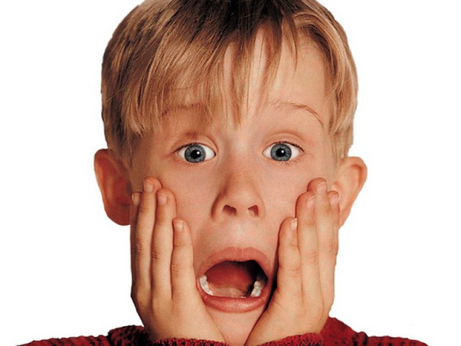
What do you feel before public speaking?
few exited butterflies
paralyzing fear
or
Notes:
or

Slide 6
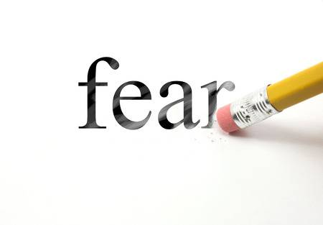
Sooooo…
Decision?

Slide 7

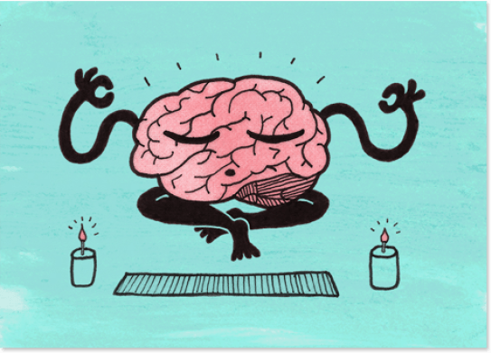
key points for your speech:
PLAN
PRACTISE

Slide 8
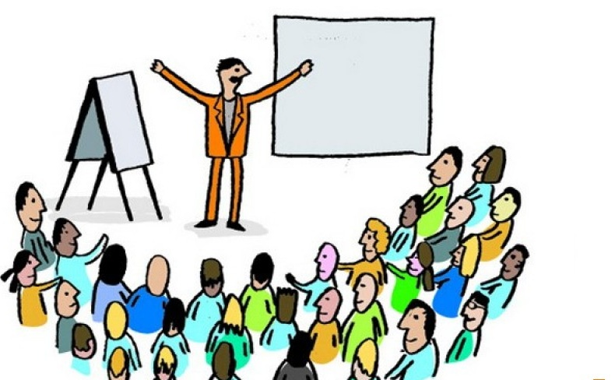

Engage with your audience
Pay attention to body language

Slide 9

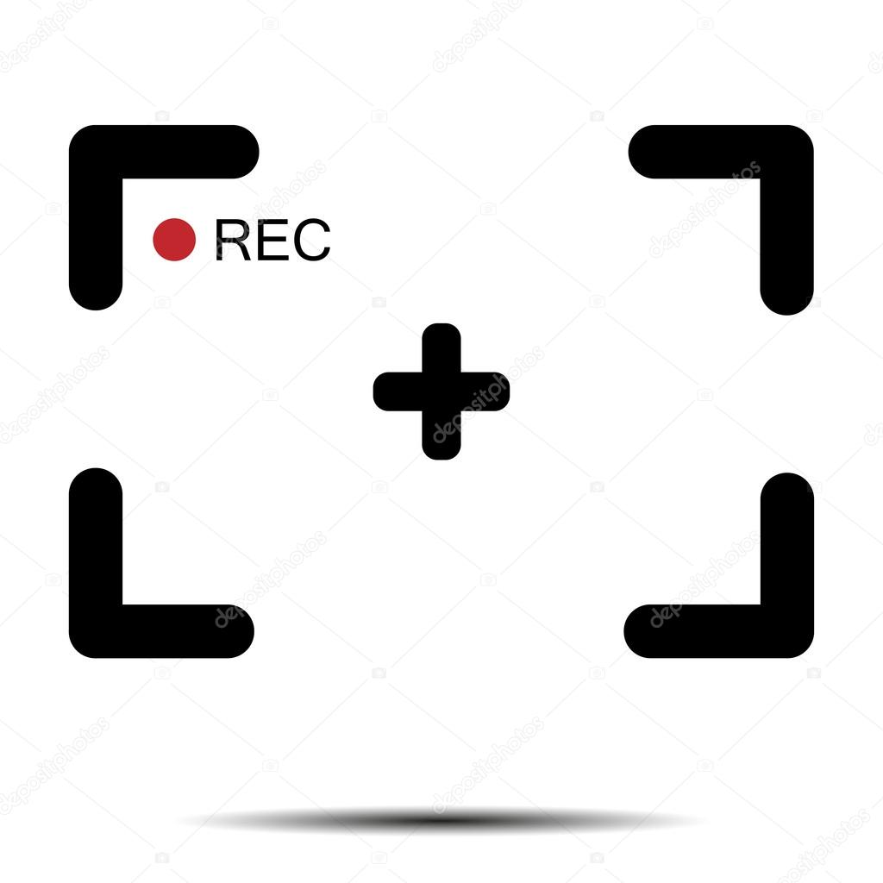
Think positively
Watch recordings of your speeches

Slide 10
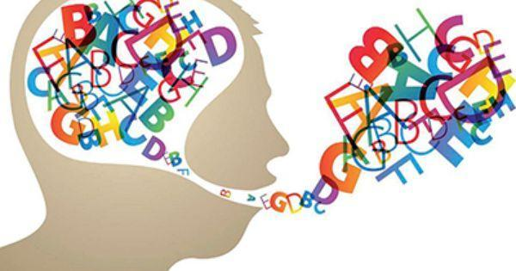
Articulation and Pronunciation

Slide 11


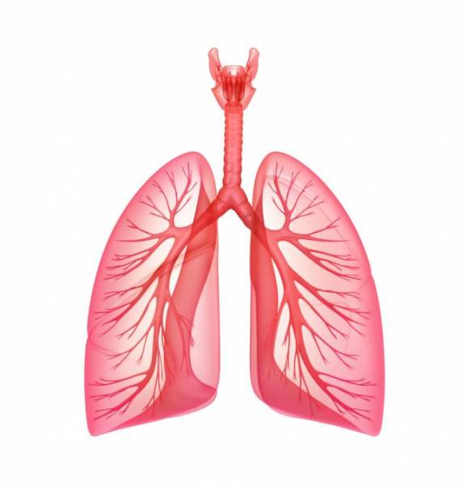
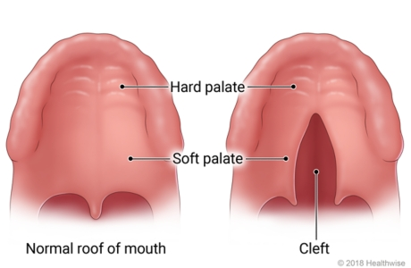

speech mechanism

Slide 12
Can the audience comprehend what you are saying?
"wabbit" rather than "rabbit."
goin' for going
'dis for this and "w" for "r"
'tin for thin and d for th
'den for then

Slide 13

Diction
or enunciation
refer to the same idea
What is it?
“going to” instead of “gonna”
or
“did not” instead of “dint”
Notes:
What is it?

Slide 14
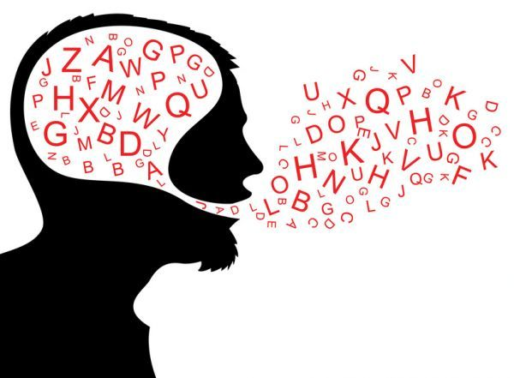
Pronunciation
The human voice is the most beautiful instrument of all, but it is the most difficult to play.
– Richard Strauss

Slide 15
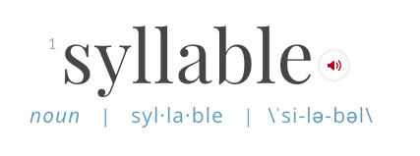
syllable
trisyllable
polysyllable
monosyllable
disyllable
Your job in pronunciation involves recognizing the different syllables that make up a word, applying the stress to the right syllable and using the right up and down pitch pattern for intonation.

Slide 16
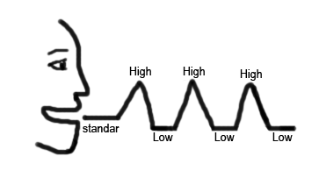
Intonation is also used in English to add function to words such as to to differentiate between wh-questions, yes-no questions, declarative statements, commands, requests, etc. You can change the meaning by varying the intonation pattern.

Slide 17
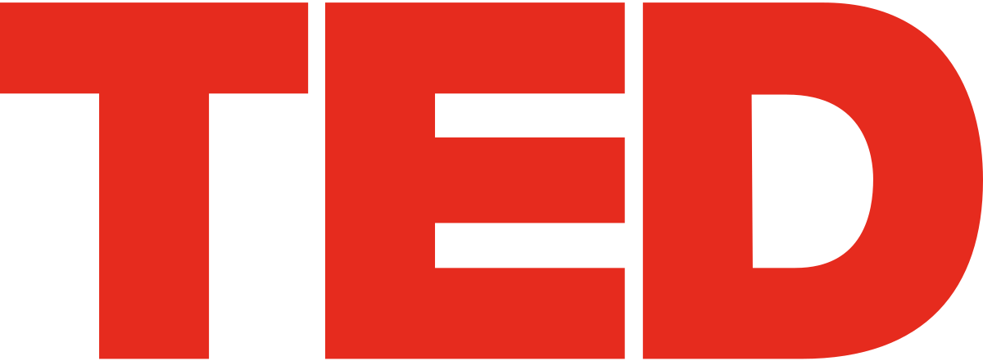
Tips for Speaker
listen to recordings of different people
download an app for your smartphone

Slide 18

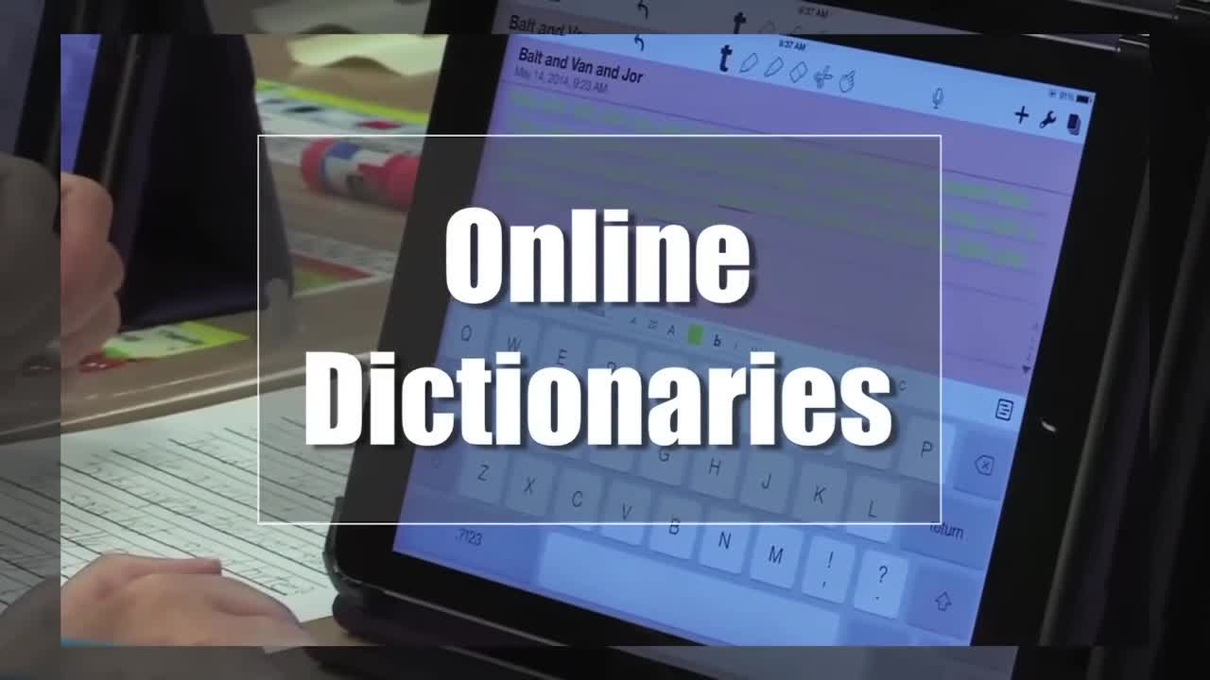
Google translate
online dictionaries

Slide 19


practice reading a story or article aloud
Go to the Merriam-Webster Dictionary website

Slide 20
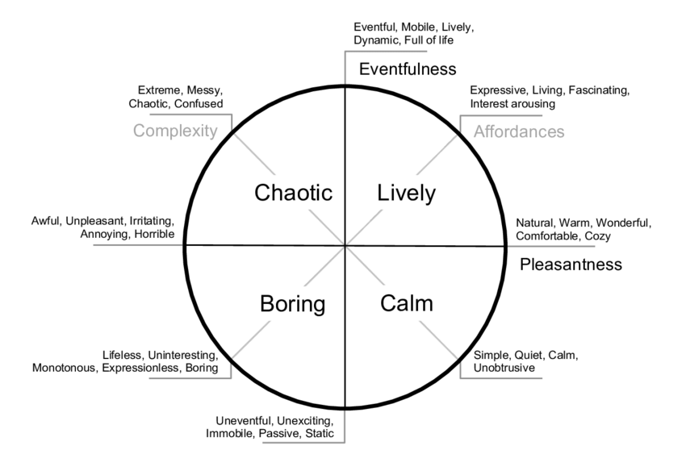

Slide 21

Vocal Aspects

Slide 22
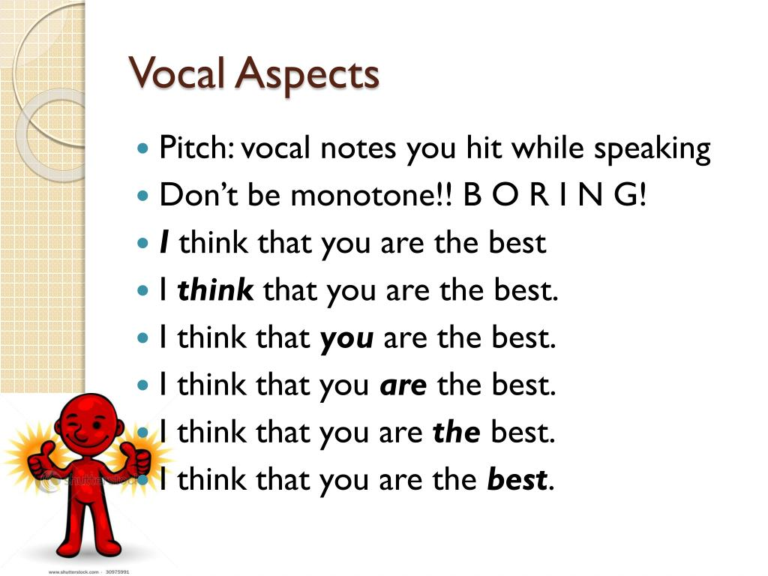

Slide 23
Pitch and Inflection
“highness” or “lowness” of the voice
variations, turns and slides in pitch to achieve the meaning
the last step in speech production

Slide 24
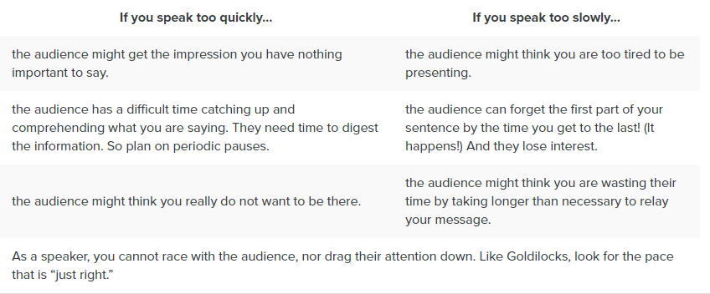
If you speak…or rate of speaking
Notes:
If you speak…

Slide 25
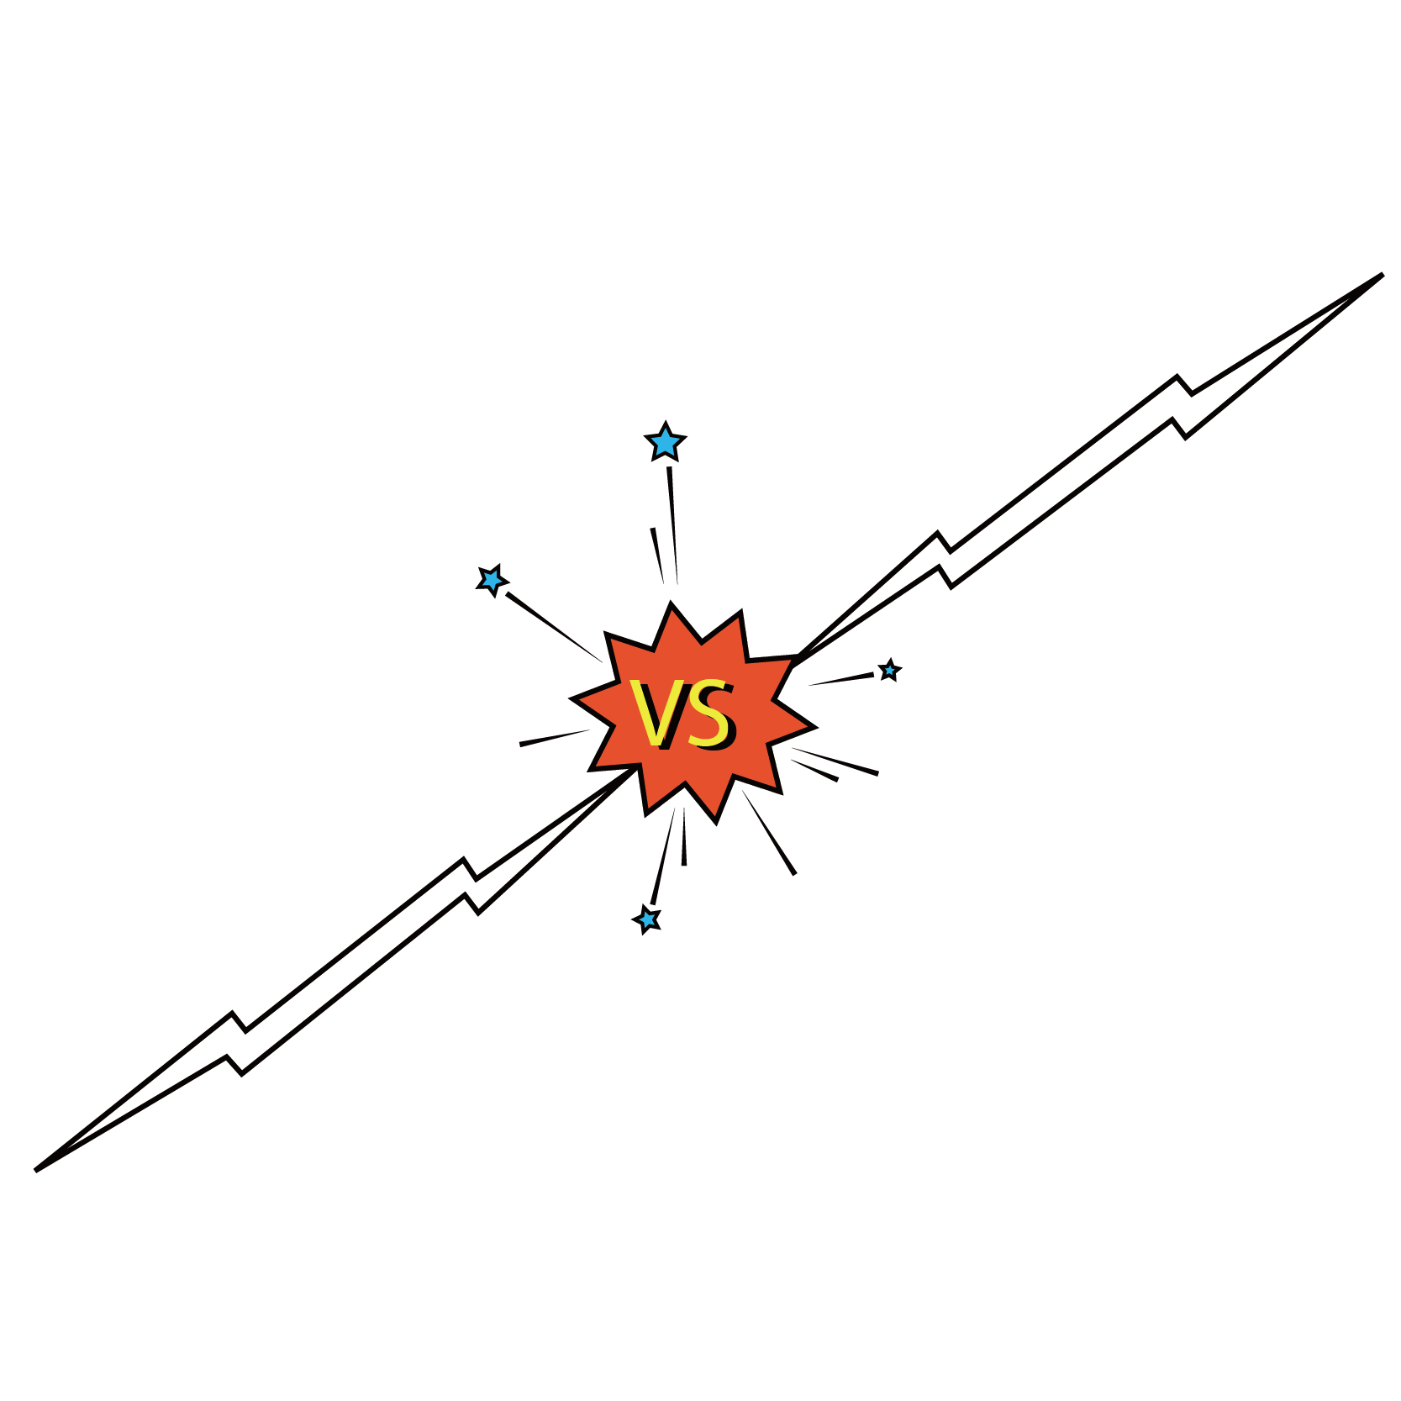
Pauses
Vocalized Pauses
It is simple nonsense to speak of the fixed tempo of any particular vocal phrase. Each voice has its peculiarities.
– Anton Seidl
Notes:
Pauses Versus Vocalized Pauses

Slide 26
One final note:
If public speaking is or will be an important part of your career, it would be sensible to have an evaluation of your voice, articulation and projection done by an objective professional so you can take any remedial action that might be recommended. There are courses of study, private lessons, and professional voice coaches to work with your voice projection, tone, and pitch.

Slide 27
The main advance:
practice, practice and PRACTICE ♥

